Slide 1
Object Oriented Programming—C++ Lecture 1: Introduction
Qijun Zhao
College of Computer Science
Sichuan University
Spring 2023

Slide 2
Something you should already know

Slide 3
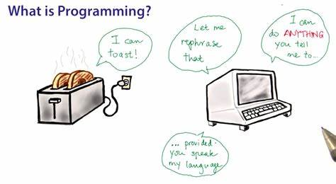
What does programming mean to ...
What does Programming mean to the world?
What does Programming mean to you?

Slide 4
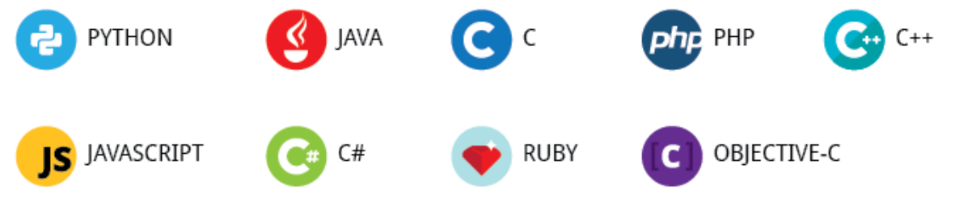
The programming languages in the world
Ruby
Javascript
Python
Java
C++
C
Assembly
Machine Code
High
Level
Low
Level

Slide 5
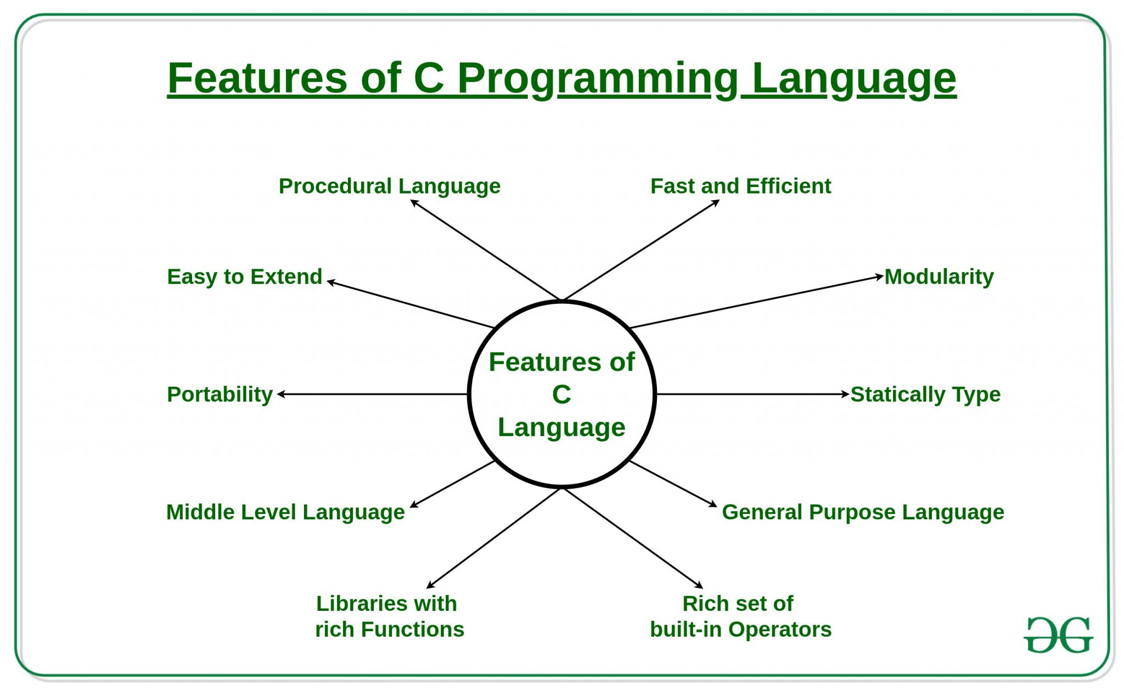
C language

Slide 6
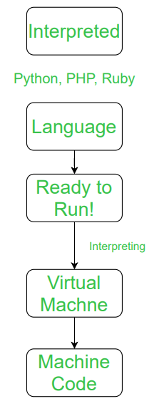
Interpreted Language vs. Compiled Language
An interpreted language is a programming language that is generally interpreted, without compiling a program into machine instructions. It is one where the instructions are not directly executed by the target machine, but instead, read and executed by some other program.
Interpreted language ranges – JavaScript, Perl, Python, BASIC, etc.

Slide 7
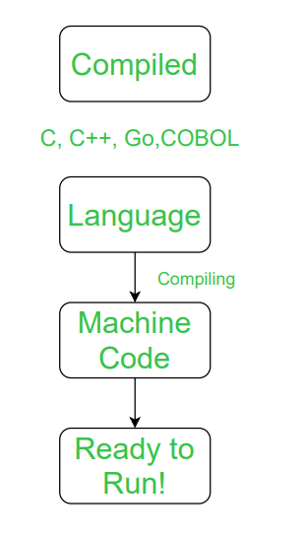
Interpreted Language vs. Compiled Language
A compiled language is a programming language that is generally compiled and not interpreted. It is one where the program, once compiled, is expressed in the instructions of the target machine; this machine code is undecipherable by humans.
Types of compiled language – C, C++, C#, CLEO, COBOL, etc.

Slide 8
Difference between Compiled and Interpreted Language
NO. | COMPILED LANGUAGE | INTERPRETED LANGUAGE
1 | A compiled language is a programming language whose implementations are typically compilers and not interpreters. | An interpreted language is a programming language whose implementations execute instructions directly and freely, without previously compiling a program into machine-language instructions.
2 | In this language, once the program is compiled it is expressed in the instructions of the target machine. | While in this language, the instructions are not directly executed by the target machine.
3 | There are at least two steps to get from source code to execution. | There is only one step to get from source code to execution.
4 | In this language, compiled programs run faster than interpreted programs. | While in this language, interpreted programs can be modified while the program is running.
5 | In this language, compilation errors prevent the code from compiling. | In this languages, all the debugging occurs at run-time.
6 | The code of compiled language can be executed directly by the computer’s CPU. | A program written in an interpreted language is not compiled, it is interpreted.
7 | This language delivers better performance. | This language example delivers relatively slower performance.
8 | Example of compiled language C, C++, C#, CLEO, COBOL, etc. | Example of Interpreted language JavaScript, Perl, Python, BASIC, etc.

Slide 9
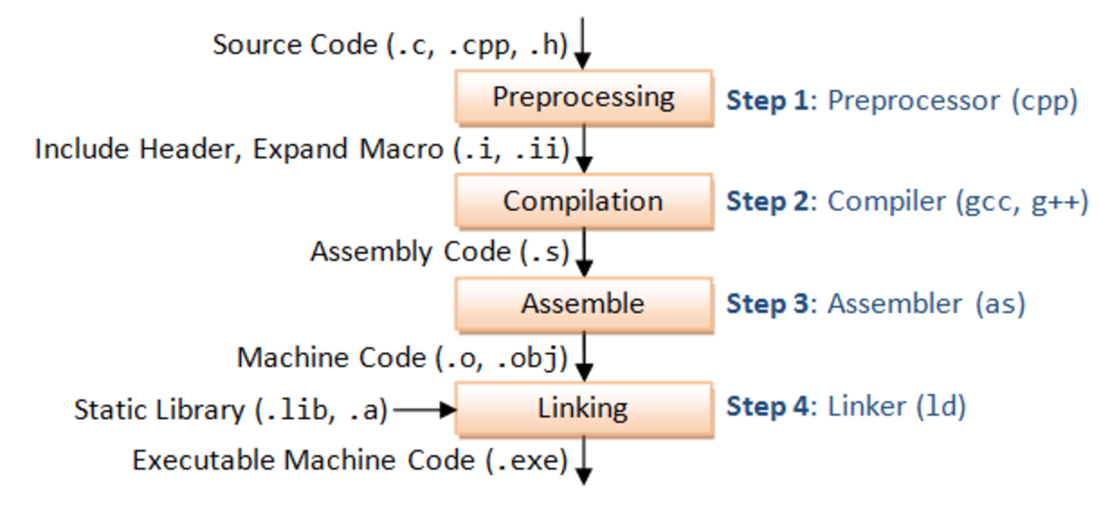
The 4 Stages of C Compilation
The compilation can split into 4 stages:
-Preprocessing
-Compilation
-Assembly
-Linking

Slide 10
About this course

Slide 11
Purpose of this course
- Exposure to standard c++ syntax and norms
- Learn key features of object oriented programming (OOP)
- Gain familiarity with powerful features of the stl
- Practice using industry standard coding tools such as ssh

Slide 12


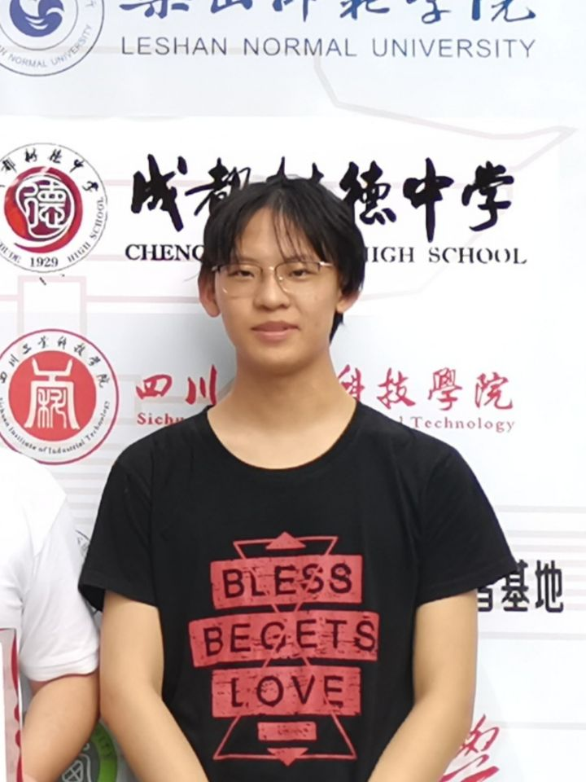

Teaching team
Lecturer
Prof. / Dr. Qijun Zhao
Teaching assistants
Hongmin Shao, A master student
Zhonghui Zhang, A junior undergraduate student (in top-notched students program)
Yuchuan Deng, A sophomore undergraduate student (in top-notched students program)

Slide 13
Course Overview
周次 | 日期 | 理论课主题 | 上机课（4-13周） | 内容
1（校历第2周） | 2月28日 | Introduction
2（校历第3周） | 3月7日 | Types and Structs Initialization and References Streams Containers Iterators and Pointers | To be announced at Week 4 | Features of C++
3（校历第4周） | 3月14日
4（校历第5周） | 3月21日
5（校历第6周） | 3月28日
6（校历第7周） | 4月4日 | Quiz I & Mid-Term Review
7（校历第8周） | 4月11日 | Classes Template Classes Template Functions Functions and Algorithms Operator Overloading Special Member Functions |  | Object Oriented Programming (OOP)
8（校历第9周） | 4月18日
9（校历第10周） | 4月25日
10（校历第11周） | 5月2日
11（校历第12周） | 5月9日
12（校历第13周） | 5月16日 | Quiz II
13（校历第14周） | 5月23日 | Move Semantics |  | Advanced Features of C++
14（校历第15周） | 5月30日 | Type Safety
15（校历第16周） | 6月6日 | Final Review
Acknowledgement: Materials of this course are mainly adapted from CS106L @ Stanford.

Slide 14

Course Grade Composition
Attendance & On-class Performance | 10%
Assignment | 20%
Quiz I | 20%
Quiz II | 20%
Final Exam | 30%

Slide 15
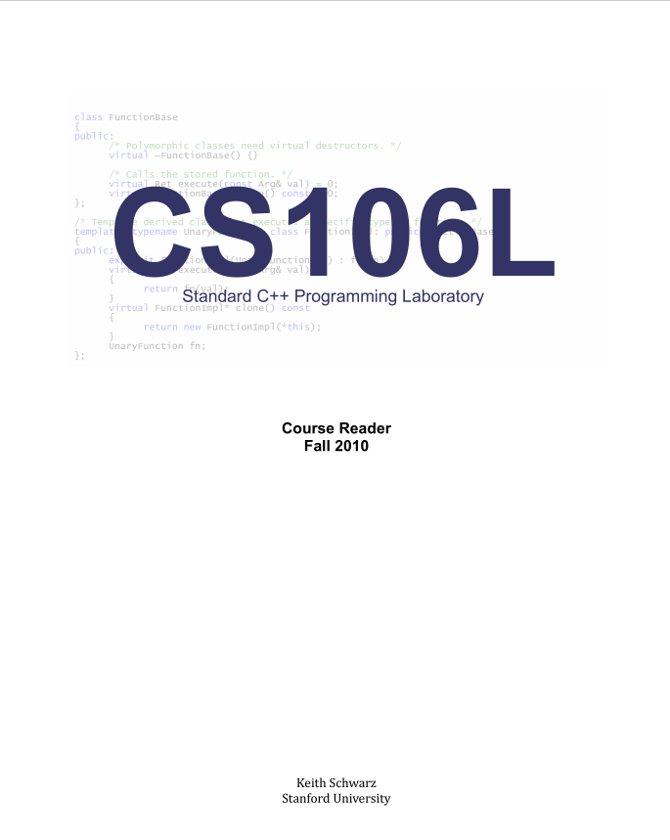
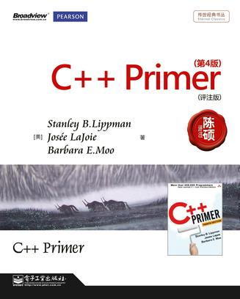
Reader
https://stackoverflow.com/questions/388242/the-definitive-c-book-guide-and-list

Slide 16
Why C++?

Slide 17
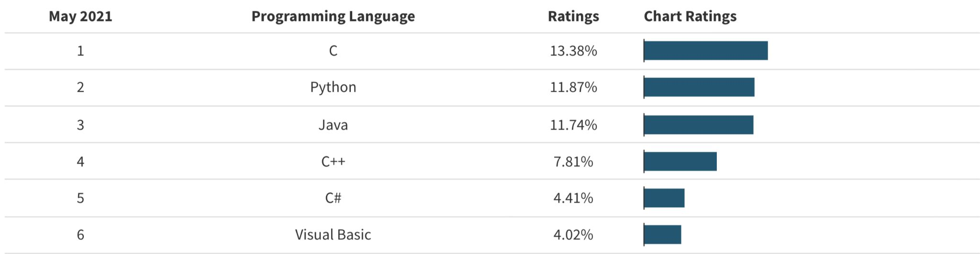
Why C++?
C++ is still a very popular language！
Tiobe Index, 2021

Slide 18
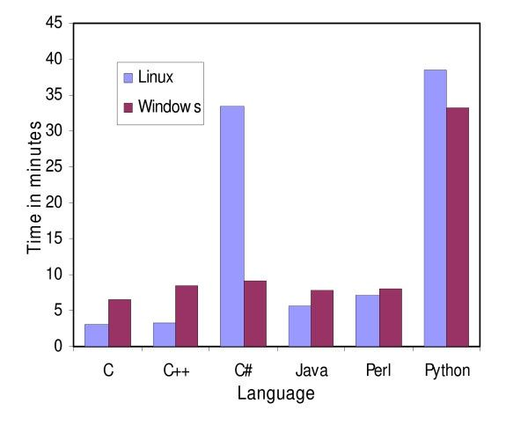
Why C++?
FAST
Ruby
Javascript
Python
Java
C++
C
Assembly
Machine Code
High
Level
Low
Level

Slide 19
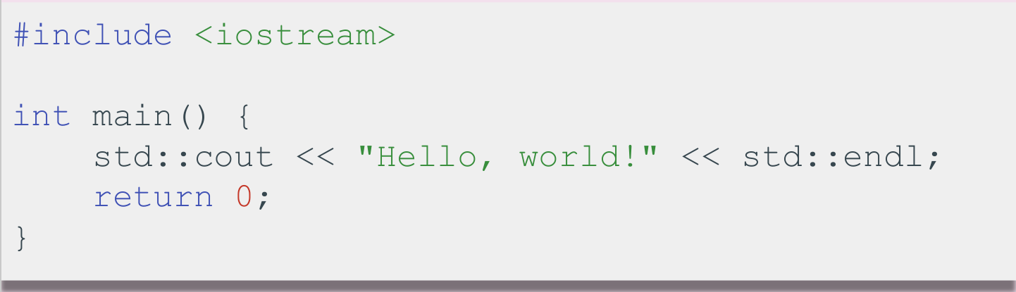
What is C++?

Slide 20
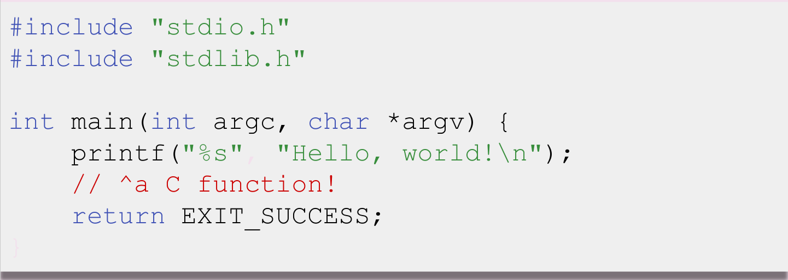
What is C++?

Slide 21
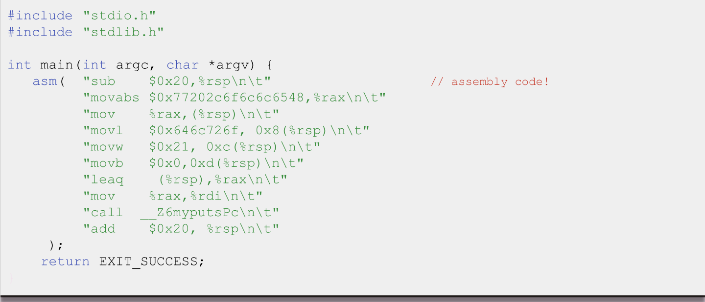
What is C++?

Slide 22
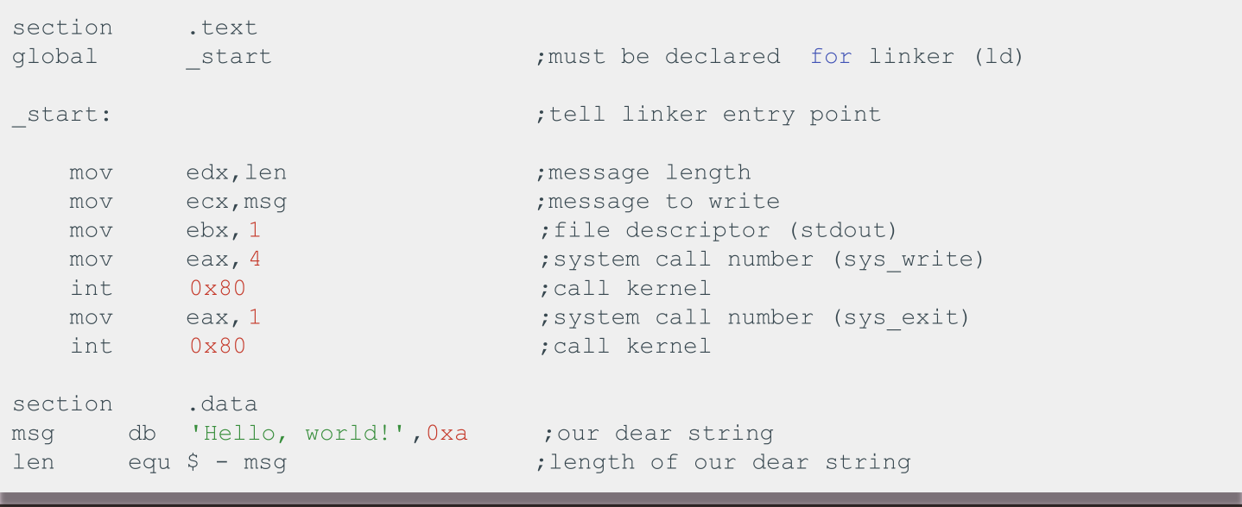
C++ History: Assembly

Slide 23
C++ History: Assembly
- Unbelievably simple instructions
- Extremely fast (when well-written)
- Complete control over your program
Why don’t we always use Assembly?

Slide 24
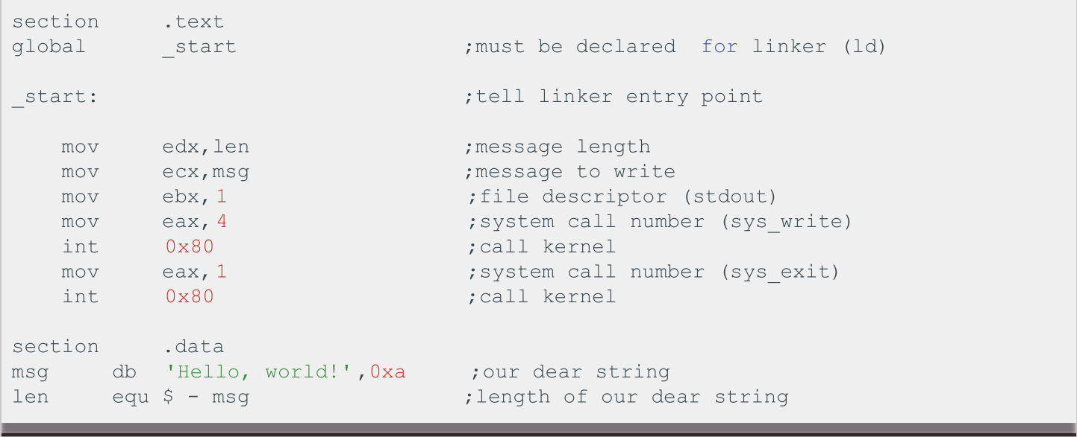
C++ History: Assembly
Assembly looks like this

Slide 25
C++ History: Assembly
Drawbacks:
- A LOT of code to do simple tasks
- Very hard to understand
- Extremely unportable (hard to make work across all systems)

Slide 26
Next in C++ History
Invention of C
Problem: computers can only understand assembly!
- Idea:
- Source code can be written in a more intuitive
language
- An additional program can convert it into assembly
- This additional program is called a compiler!

Slide 27

C++ History: Invention of C
- T&R created C in 1972, to much praise
- C made it easy to write code that was
■ Fast
■ Simple
■ Cross-platform
Ken Thompson and Dennis Ritchie, creators of the C language.

Slide 28
C++ History: Invention of C
- C was popular because it was simple.
- This was also its weakness:
- No objects or classes
- Difficult to write generic code
- Tedious when writing large programs

Slide 29
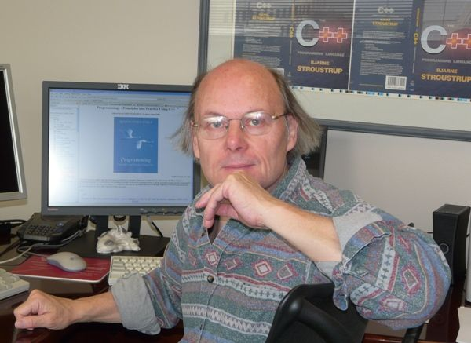
C++ History: Welcome to C++!
- In 1983, the beginnings of C++ were created by
Bjarne Stroustrup.
- He wanted a language that was:
- Fast
- Simple to use
- Cross-platform
- Had high-level features

Slide 30
C++ History: Evolution of C++
We are here
C++
C++ 03
C++ 14
C++ 20
1979
1983
1998
2003
2011
2014
2017
2020
？
C with
Classes
C++ 98
C++ 11
C++ 17
C++ 23

Slide 31
Design Philosophy of C++
- Only add features if they solve an actual problem
- Programmers should be free to choose their own style
- Compartmentalization is key
- Allow the programmer full control if they want it
- Don’t sacrifice performance except as a last resort
- Enforce safety at compile time whenever possible

Slide 32
Design Philosophy of C++
- Only add features if they solve an actual problem
- Programmers should be free to choose their own style
- Compartmentalization is key
- Allow the programmer full control if they want it
- Don’t sacrifice performance except as a last resort
- Enforce safety at compile time whenever possible

Slide 33
Design Philosophy of C++
- Only add features if they solve an actual problem
- Programmers should be free to choose their own style
- Compartmentalization is key
- Allow the programmer full control if they want it
- Don’t sacrifice performance except as a last resort
- Enforce safety at compile time whenever possible

Slide 34
But... What is C++?

Slide 35
C++: Basic Syntax & the STL
Basic syntax
- Semicolons at EOL
- Primitive types (ints,doubles etc)
- Basic grammar rules
The STL
- Tons of general functionality
- Built in classes like maps, sets, vectors
- Accessed through the namespace std::
- Extremely powerful and well-maintained

Slide 36
How to learn and practice?

Slide 37
Coding for love, Coding for the world
Qijun Zhao
qjzhao@scu.edu.cn

